Slide 1
Link Prediction and Node Classification in Cora Citation Network
Course : Massive Data Mining (16:198:550)
Course Instructor: Yongfeng Zhang, PhD
Submitted by:
Arathi Reghukumar ar1778
Swathi Doraiswamy Gopal sd1322

Slide 2
Content
Problem Statement
Data Insight
Approach
Evaluation
Conclusion
Future Work

Slide 3
Problem Statement
Graph analysis is a widely used structure in various applications such as social networks, citation networks, molecular graphs, etc.
The cora dataset provides data for graph analysis, including link prediction and node classification tasks
In this project we provide two approaches and do a deep dive analysis on each of the approaches to Link prediction and Node classification

Slide 4
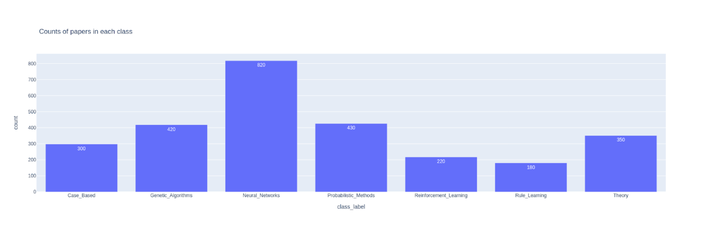
Data Insight
The Cora dataset consists of 2708 scientific publications classified into one of seven classes. The citation network consists of 5429 links. Each publication in the dataset is described by a 0/1-valued word vector indicating the absence/presence of the corresponding word from the dictionary. The dictionary consists of 1433 unique words.

Slide 5
Approach
Project Tasks
Methods
Data pre pressing and split, create a training dataset and a testing dataset for experiment
Logistic Regression
Link Prediction, an algorithm to predict the links in the testing
2. GraphSage
Node classification, prediction of node labels in the testing dataset and evaluation based on precision, recall, F- measure.

Slide 6
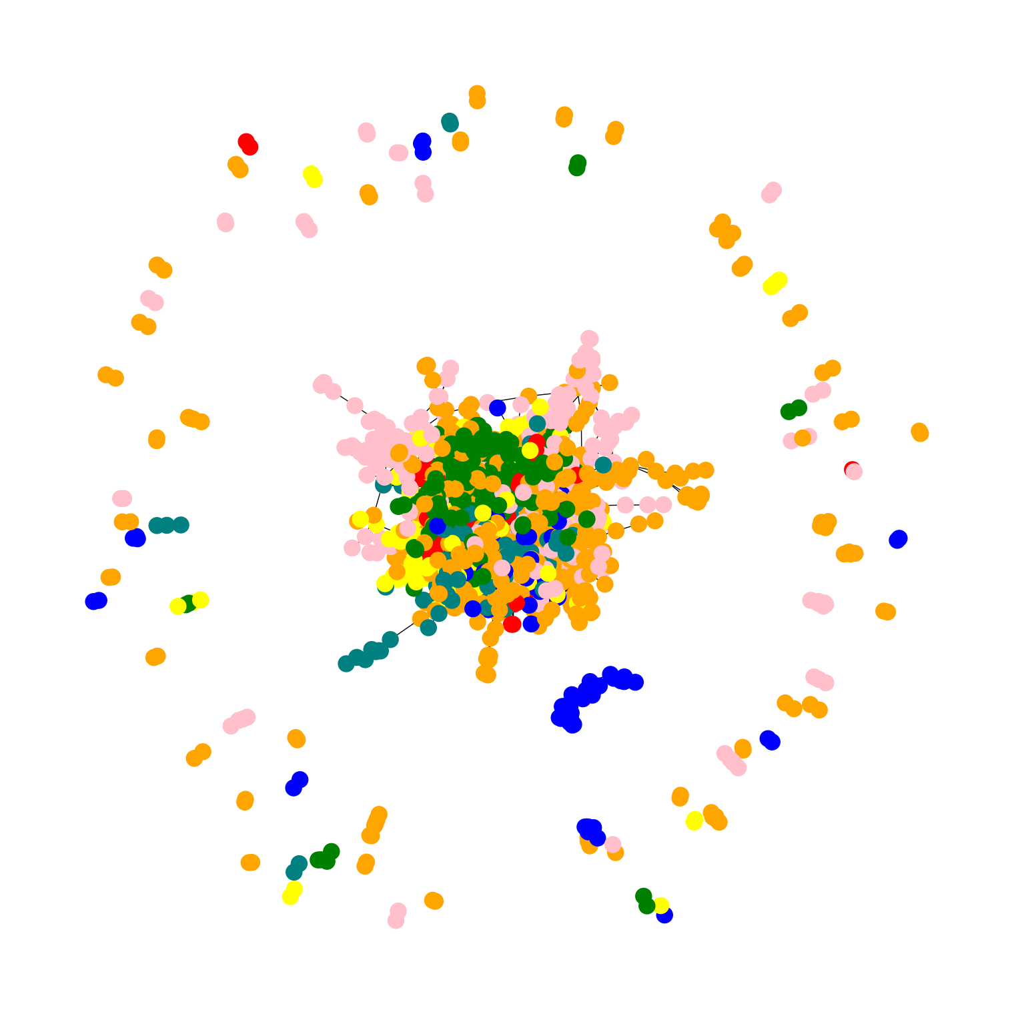
Exploratory Data Analysis
Green: Genetic Algorithms,
Red: Reinforcement Learning,
Teal: Theory
Blue: Rule Learning
Yellow: Case Based
Pink: Probabilistic Methods
Orange: Neural Networks

Slide 7
GraphSAGE
GraphSAGE is an iterative algorithm that learns graph embeddings for every node in a certain graph.
Prior to GraphSAGE, most node embedding models were based on spectral decomposition/matrix factorization methods, which were transductive and did not perform well on unseen data.
The GraphSAGE algorithm follows a two step process.
-Aggregate: Aggregate neighbouring node representations for our target node.
-Update: After obtaining an aggregated representation for node v based on its neighbours, the current node v is updated using a combination of its previous representation and the aggregated representation.
The output of one round of GraphSAGE involves finding new node representation for every node in the graph.

Slide 8
Implementation
The model we created is made up of a single layer of a 32x32 GraphSAGE Model whose inputs are the sampled inputs aggregated by the generator
The model then generates vectorized inputs and vectorized outputs that can be sent to a single dense layer of a neural network, the outputs of which are then supplied to a softmax output layer to enable for multi-class classification.
For the link prediction, we use the multiply operator to concatenate the node vectors and obtain a score for the existence of a link between the nodes.
For Node classification,The embeddings are fed into a single layer of a typical neural network, and the labels (in one-hot vector form) are fed out. The final output layer in a typical multi-class classification problem is a softmax layer. We use the graphSAGE model to produce an embedding for the node in the context of the graph, which we then input to the predictor of the dense model we designed to categorize previously unknown nodes.

Slide 9
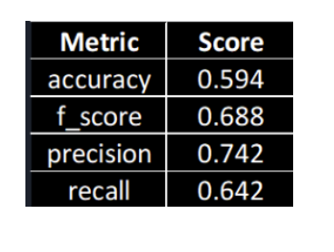
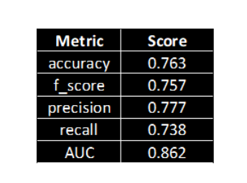
Evaluation- Link Prediction
Logistic Regression
Graph Sage

Slide 10
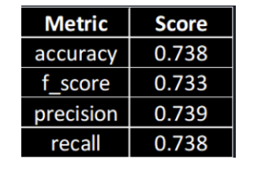
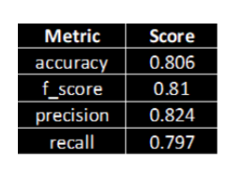
Evaluation- Node Classification
Logistic Regression
Graph Sage

Slide 11
Conclusion
From the accuracy, precision, recall and F-score values, we find that GraphSAGE performs better when compared to Logistic Regression both for the task of Link Prediction as well as Node Classification.
Hence, GraphSAGE is an efficient algorithm for the task.

Slide 12
Future Work
We recommend developing a more advanced ensemble model of GraphSAGE, GCN, and other effective models in the future.
To achieve better node or link embeddings, we intend to improve feature engineering by developing a robust feature transformation and selection approach.
To improve the accuracy of the present models, we propose more thorough hyperparameter adjustment.
We intend to improve the data by balancing the samples in each class.

Slide 13
Thank You!!

